Slide 1
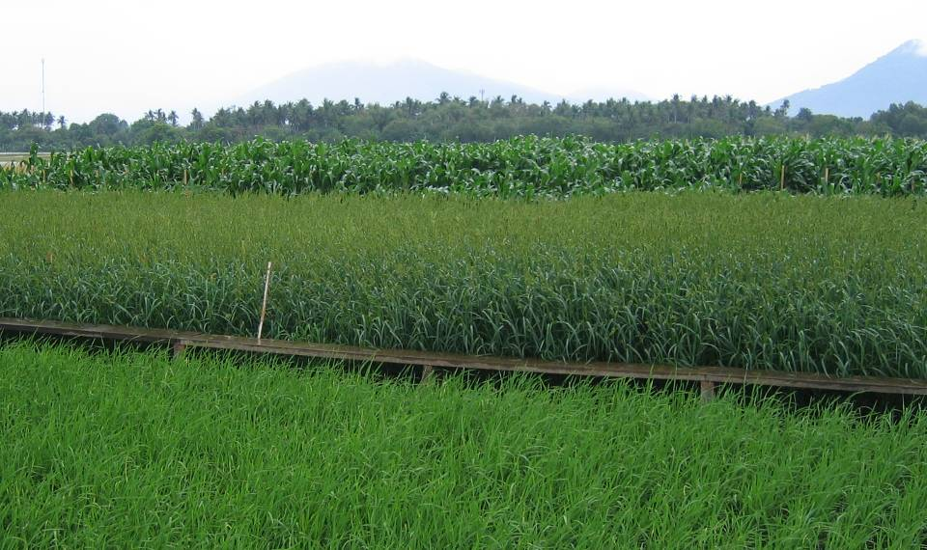
The evolution of C₄ photosynthesis
Julian M Hibberd
Department of Plant Sciences,
University of Cambridge, UK
Notes:
Thank to
Image shows why into modi curr C3 crops to C4

